Slide 1

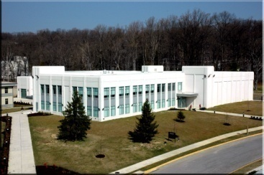
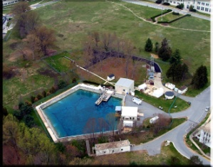

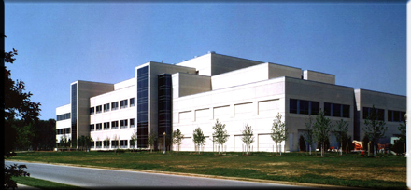
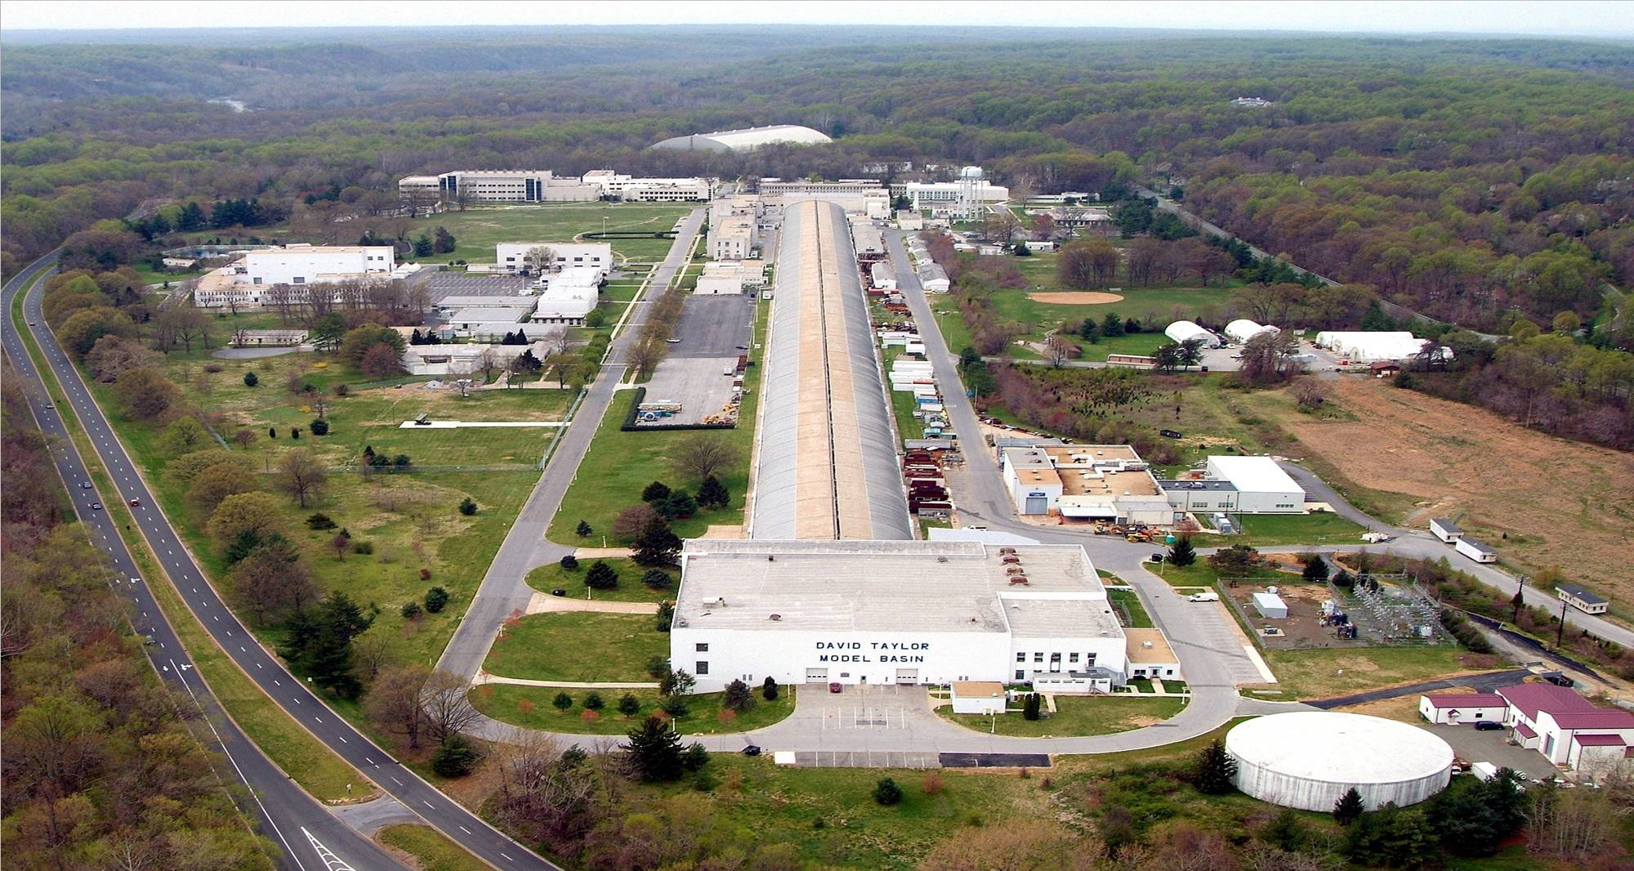

NSWC, Carderock Division
West Bethesda, Maryland
NSWC, Carderock Division
West Bethesda, Maryland
NREL BRIEF
Marine & Aviation Division, Code 5300
David B. Coakley, Stephen Ebner,

Slide 2
ADMINISTRATIVE SLIDE
BRIEF AUTHORS
  DAVID B. COAKLEY – NSWC CODE 5300 SENIOR RESEARCH ENGINEER SIMULATION AND TOOL DEVELOPMENT
  RICH BANKO – C-PLANE PROJECT LEAD AT NSWCCD
  STEPHEN EBNER – NSWC CODE 5300 DIVISION HEAD
DCAB CODE DEVELOPERS
  DAVID B. COAKLEY – NSWC CODE CURRENT CODE DEVELOPER
  RICHARD KNUTSON – NSWC CODE 53 RETIRED, ORIGINAL PRIMARY CODE DEVELOPER
  JOHN JOHNSTON – NSWC CODE 53 RETIRED, ORIGINAL CODE DEVELOPER
DELIVERED ON APRIL 24, 2012
  JAPANESE INVESTORS PERSONNEL
  U.S. SPONSORS (ECOMERITEC), INCLUDING A. FLEMING
  BRIEF DELIVERED AT NSWC CARDEROCK

Slide 3
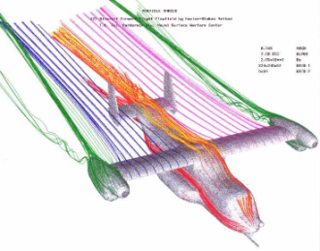
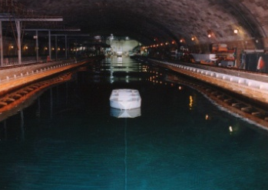
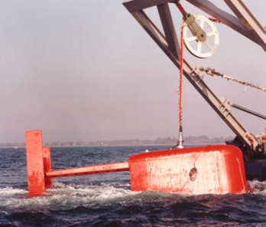
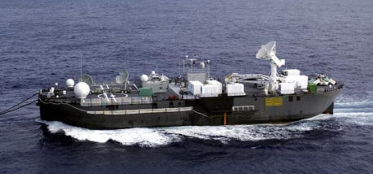
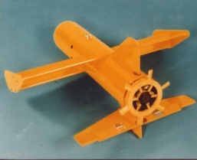
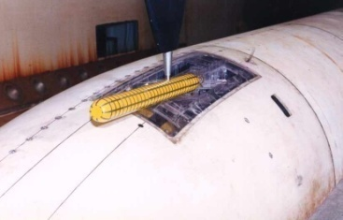
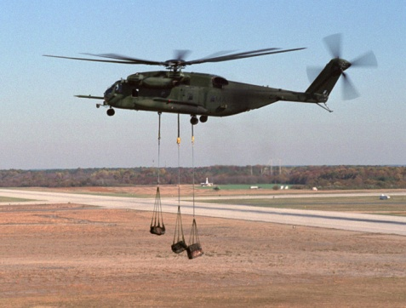
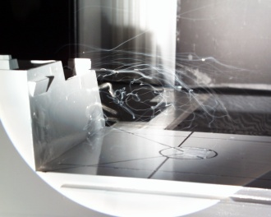
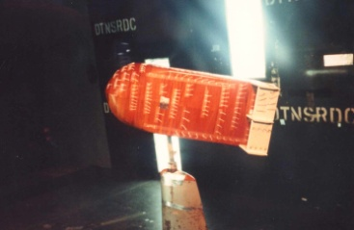
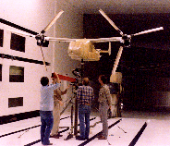
Marine & Aviation Division Technical Capabilities
Analytical Simulations
  Towed/Tethered Vehicles, UUVs, UAVs, Moored Platforms Dynamics
  Aircraft Aeromechanics
Engineering Design, Systems and Conceptual Development
  Towed/Tethered & Moored Systems, UUVs
  UAVs, Airframe Structures, Rotary Wing Aircraft
Laboratory Evaluations (Model & Full-Scale)
  NSWCCD Hydro Facilities, Wind Tunnel, Other Facilities, Electronics Lab
Field Evaluations
  Marine Systems (Submarines, Surface Ships, Surface Craft)
  Rotary Wing Aircraft
Fleet Support
  Operational Demos

Slide 4
VEHICLE DYNAMIC SIMULATION
Hydrodynamic Design
Performance Prediction
Performance Optimization
Open-Loop Response
Control Response
Maneuvering

Slide 5

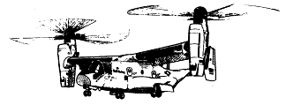
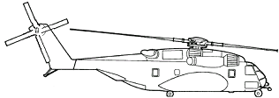
AIRCRAFT MODELING & SIMULATION
FLIGHT DATA
Relational Databases
  Flight Test Data
  Operational Data
Analysis
  Correction for Measurement Error
  Random Characteristics (Buffet)
  Neural Network & AI
  State Space Identification
  Regime Recognition & Assessment
  Usage Monitoring
Rotorcraft Applications
STRUCTURES
Finite Element Models
  Statics / Dynamics / Aeroelastic
  Nonlinear Crash / Impact
Loads
  Design Loads
  Loads Derived from Flight Data
  Gun Firing Loads
CAD Models for V22
INTEGRATED MODELS
Comprehensive aeromechanical simulation
  Flexible Fuselage / Blades
  Rotor Downwash
  Steady/Unsteady Aerodynamics
  Nonlinear Control System
  Pilot model
  Engine/Drivetrain Dynamics
  Sling loads/towed bodies
  Stores jettison
Other Applications
Sub-surface vehicles, UUV’s
Marine propellers
Towed bodies
Multi-vehicle simulation
Air-ship interface simulation
AERODYNAMICS
Wind Tunnel Data
Rotor Inflow/Downwash/Outflow & Vortex Ring State
Fuselage
CFD

Slide 6
DCAB ANALYSIS
CABLE-BODY SIMULATION
TOW PLATFORM MOTIONS
  EXTERNAL DATA FILE OR
  INPUT COMMANDS
MOORED TOWPOINTS
  CURRENTS VARYING WITH TIME/DEPTH
  TURBULENCE CHARACERISTICS (TBD)
  SINGLE TOWPOINT, WITH 2ND AVAILABLE (WILL BE EXTENDED TO MULTIPLE TOWPOINTS)
WAVES – 1ST ORDER, PIERSON MOSKOWITZ OR BRETCHNEIDER
BUOY HYDRODYNAMIC MODEL
CABLE HYDRODYNAMIC MODEL
SIMULATION PROCESS
WINCH MODEL – TYPICALLY INCLUDES CONTROL SYSTEM
DESCRIBED IN REPORT CARDEROCKDIV-92/003, APRIL 1992

Slide 7
DCAB ANALYSIS
VEHICLE COORDINATES
SUBMARINE COORDINATE SYSTEM
DEFINED IN GERTLER AND HAGEN (1967) AND IMLAY (1959)
ROLL
YAW
USED EXCLUSIVELY SINCE THEN
PITCH
CABLE

Slide 8
DCAB ANALYSIS
BUOY HYDRODYNAMIC MODEL
HYDRODYNAMIC COEFFICENTS DETERMINATION
  BODXYZ
  WIND TUNNEL
  COMMERCIAL ROTORCRAFT CODE (FOR ROTORS)
  UP TO 201 COEFFICIENTS CAN BE INPUT (BUT SOME ARE TYPICALLY ZERO), INCLUDING ADDED MASS
    VERT PLANE EX. Xuu, Zuw, Zw|w|, Muw, Muq,
    LATERAL PLANE EX. Yuv, Nuv, Nur
  STREAMLINED METHODS FOR COEFFICENT DETERMINATION
PHYSICAL PROPERTIES
  BG/CG
  MOMENTS OF INERTIA
WAVES – 1ST ORDER, PIERSON MOSKOWITZ OR BRETCHNEIDER

Slide 9
DCAB ANALYSIS
CABLE MODEL
HYDRODYNAMIC COEFFICENTS DETERMINATION
  LOADING FUNCTIONS
    DEVELOPED AT DTMB BY PODE AND OTHERS
    CLASSIC REPORTS IN THE 1970-1990s
  THEORY
  WATER BASIN TESTING
SIMPLIFICATION REGARDING MASS
  INCLUDED IN STEADY CALCULATIONS
  NOT INCLUDED IN DYNAMIC CALCULATIONS
    ALMOST ALWAYS A VERY SMALL CONTRIBUTOR TO FORCES IN CABLE SYSTEMS, EXCEPT FOR SNAP LOADING
    NOT NECESSARY FOR DESIGN PURPOSES
    IN SNAP LOADING, THE CABLE MASS IS STILL OFTEN NOT A LARGE CONTRIBUTOR TO SYSTEM INERTIAL LOADING
    GREATLY INCREASES SPEED OF COMPUTATION
  IF DYNAMICS REQUIRE MASS, CODE 53 USES OTHER PROGRAMS SUCH AS SEADYN

Slide 10
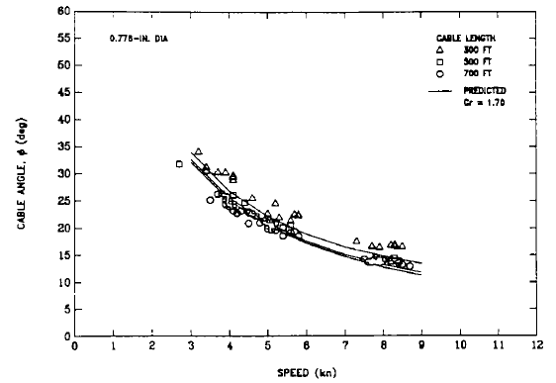
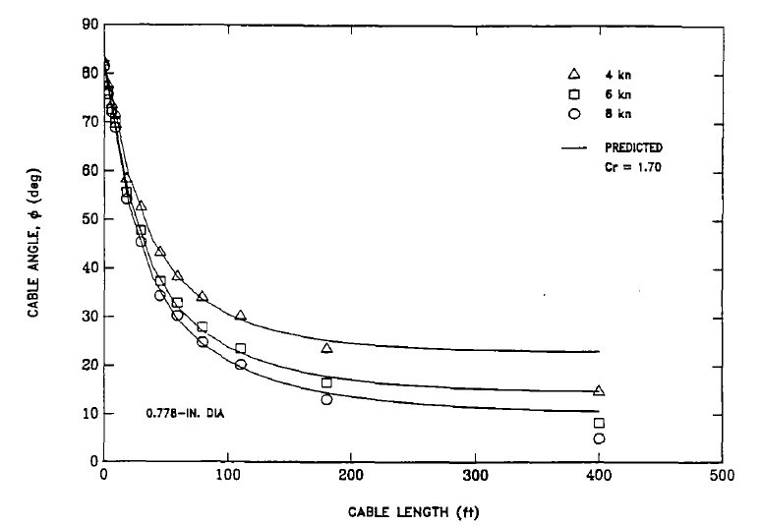
DCAB ANALYSIS
CABLE MODEL - EXAMPLES
RESEARCH DEPRESSOR
CABLE ANGLE NEAR SHIP
RESEARCH DEPRESSOR
CABLE ANGLE NEAR BODY
TENSION IS SIMILARLY ACCURATE

Slide 11
DCAB ANALYSIS
CABLE MODEL - EXAMPLES
TOWED VEHICLE
  SUBMERGED TOWPOINT
  SEA STATE 5
  MODERATE SPEED
  24 FT HIGH WAVE
SPEED THROUGH WATER EXCEEDS 2X TOW SPEED
DYNAMIC ANALYSIS SHOWN
NO EXPERIMENTAL DATA AVAILABLE, YET

Slide 12
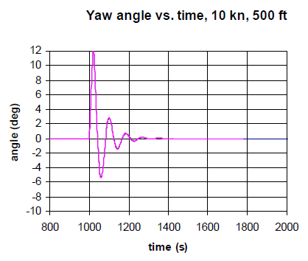
DCAB ANALYSIS
CABLE MODEL - EXAMPLES
LARGE AIRBORNE TOWED VEHICLE
PERTURBATION RUN
DISPLACEMENT OF BODY SHOWN
TWO CURVES DONE
  EXISTING BLIMP
  MODIFIED BLIMP
USED TO JUDGE DYNAMICS OF MODIFIED BLIMP
NO EXPERIMENTAL DATA AVAILABLE

Slide 13
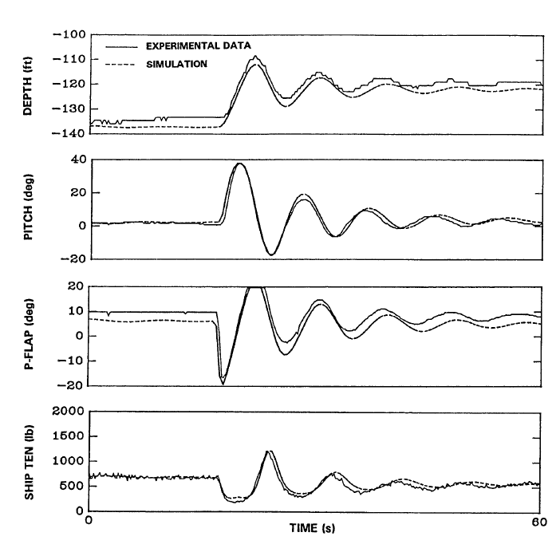
DCAB ANALYSIS
CABLE MODEL - EXAMPLES
SUBMERGED TOWED VEHICLE
SURFACE TOW
RESPONSE TO DEPTH PERTURBATION
BODY EQUIPPED WITH REMOTELY CONTROLLED FLAPS

Slide 14
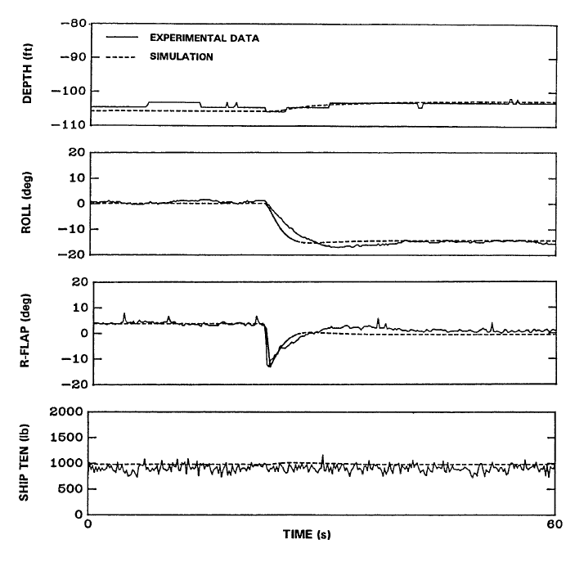
DCAB ANALYSIS
CABLE MODEL - EXAMPLES
SUBMERGED TOWED VEHICLE
SURFACE TOW
RESPONSE TO ROLL COMMAND
BODY EQUIPPED WITH REMOTELY CONTROLLED FLAPS

Slide 15
DCAB ANALYSIS
SIMULATION PROCESS
PC BASED SOLUTIONS
MANY TIMES REAL TIME
  LARGE BODIES ~1000 LONG TONS: UP TO 10,000 TIMES FASTER THAN REAL TIME
  SMALLER BODIES: SEVERAL HUNDRED TIMES FASTER THAN REAL TIME
SEVERAL DOZEN TO SEVERAL THOUSAND SIMULATIONS PER PROJECT DEPENDING ON NEED
VERY VALUABLE TO THE NAVY
  SPEED
  ACCURACY

Slide 16
DCAB ANALYSIS
WORK TO DATE
TWO DECADES OF WORK WITH DCAB
OVER 100 DEPARTMENTAL REPORTS, OVER 100 UNFORMALLY REPORTED SIMULATION STUDIES
  SUBMERGED TOWED BODIES
  SURFACED TOWED BODIES
  MOORED ARRAYS
  BLIMPS
SEVERAL STUDIES FOR COMMERCIAL COMPANIES THROUGH CRADAS AND WORK FOR PRIVATE PARTIES
  OTHER ENERGY CONVERSION DEVICES
  SUBMERGED TOWED BODIES
  (AND NOW) MULTI ROTOR MOORED SYSTEMS

Slide 17
AQUANTIS TURBINE
REALIZED VERY EARLY THAT ROTORS DOMINATE VEHICLE FORCES AND MOMENTS
  NEEDED COEFFICIENT MODEL OF ROTORS
  FLIGHTLAB SELECTED TO PROVIDE FORCES AND MOMENTS
    STANDARD COMMERCIAL ROTORCRAFT CODE
    FLIGHTLAB FORCES/MOMENTS COMPARISION
      WTPERF(ARL)
      UNSTEADY RANS(ARL)
      FLIGHTLAB AGREES TO WITHIN A FEW PERCENT
  EXISTING CURVEFITTING ROUTINES FOR COEFFICIENTS
  DIRECTLY IMPORTED INTO DCAB
KEY ASSUMPTION IS THAT TIP SPEED RATIO IS MAINTAINED THROUGHOUT SIMULATION

Slide 18
AQUANTIS TURBINE, 2
CHANGES REQUIRED TO DCAB
  MULTIPLE ROTORS
    GYROSCOPIC MOMENTS ON VEHICLE
    VERTICAL SHEAR
    EFFECT OF AXIAL INDUCTION FACTOR ON ‘WING’
  MULTIPLE COMPONENT DEFINITION
    ALLOWS MULTIPLE ROTORS, FUSELAGES, WINGS, AND CONTROL SURFACES
  TWO CABLE MODELING PROCEDURE DEVELOPED
    TWO FORWARD LINES MODELED BY ONE CABLE
    VERTICAL MOORED LINE ANALYSIS
  CURRENT CHANGES AS A FUNCTION OF TIME
    CHANGES IN ENVIRONMENTAL CURRENT
    VARIATION IN Z MAINTAINED

Slide 19
AQUANTIS KEY DYNAMIC STAB. FINDINGS (4 ROTORS)
IN RESPONSE TO CHANGES IN CURRENT DIRECTION OF UP TO 70 DEGREES, VEHICLE WEATHERVANES INTO FLOW UP TO A POINT
AT SOME AZIMUTHAL ANGLE THE VEHICLE LOSES UPWIND ORIENTATION AND REVERTS TO MOORED ORIENTATION
  DUE TO MOMENTS FROM CABLES CAUSED BY BUOYANCY OVERPOWERING ROTOR YAW MOMENTS
  IDEAL FOR C-PLANE, SINCE THIS REDUCES CHANCES OF TANGLING MOORING LINES

Slide 20
Static Stability
Static stability refers to the ability to react to static (weight & buoyancy) and steady hydrodynamic forces (rotor & structure) induced on the platform to seek a neutral and balanced attitude not resulting in increasing forces and moments
Three planes of static stability to consider:
  Vertical or pitch plane (forces in the z-direction, moments about the y-axis)
  Lateral or yaw plane (forces in the x-direction, moments about the z-axis)
  Horizontal or roll plane (forces in the y-direction, moments about the x-axis)

Slide 21
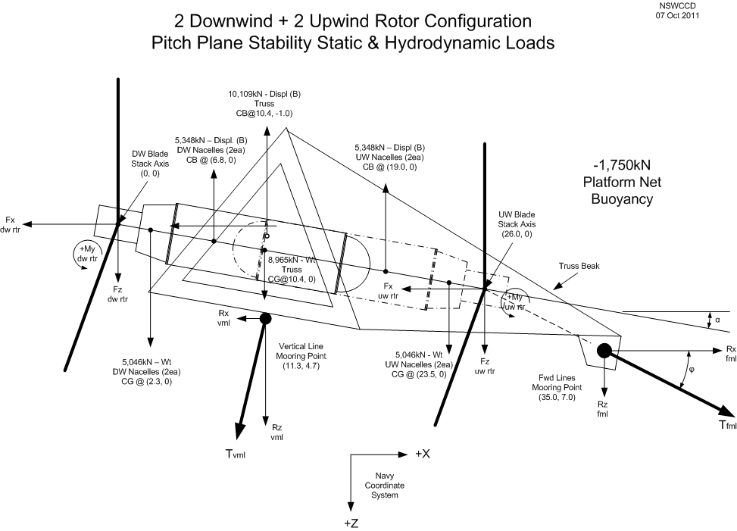
Pitch Plane Free-Body Diagram
Sum of the Moments about Mooring Point Y-axis = 0

Slide 22
Rotor Forces
40m_950kW_2-blade Rotor_TSR 10
Rotor Thrust/Drag, Fx (kN)
Rotor Torque, Mx (kN-m)
Flow Velocity (m/s)
Flow Velocity (m/s)

Slide 23
Platform Stability
Platform General Performance

Slide 24
Platform Stability
Platform Dive Performance at High Currents

Slide 25
Platform Stability
Platform Mooring Line Tension

Slide 26
Platform Stability
Simulation Model
  Variant of DCAB used for modeling
    Waves
    Currents
  Modified to include
    Multiple bodies
    Gyroscopic loading
    Changing mass, CG, CB and towpoint locations
    Higher fidelity current definition
  Expected to have good accuracy, sufficient for this project
  Very fast – 14,000 seconds of simulation time in about 15 seconds
  Limitations
    Nacelles not include (previous work includes about 20% degrade in destabilizing moments
    Truss not included
      drag of about 10% of rotors at design conditions, so not so important for design conditions
      Very important for platform motions when the rotors are stopped
    Wing can and has been included, but study of this version has been discontinued

Slide 27
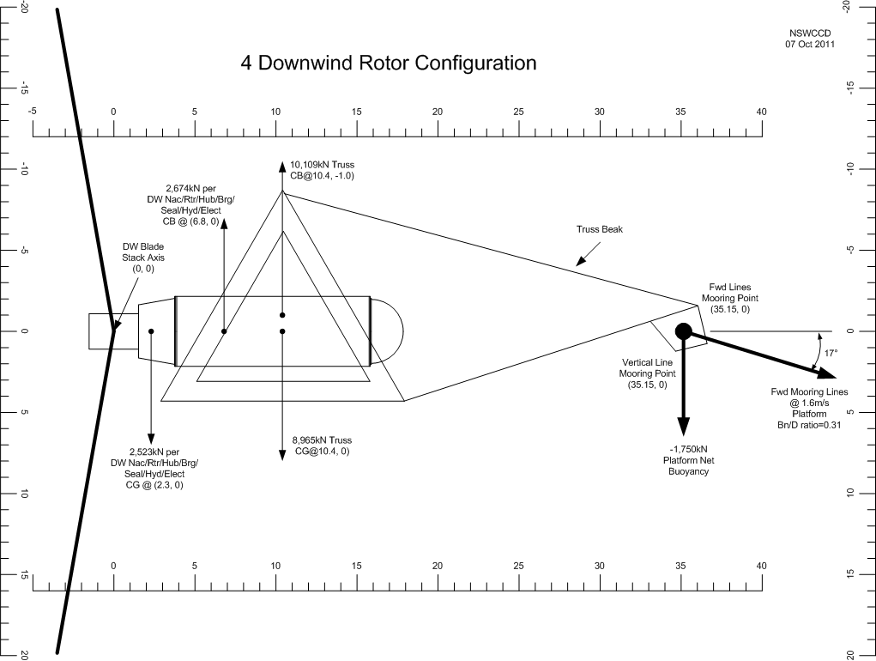
Platform Stability
Mooring Point Locations Required for 4 Downwind Rotors
Notes:
Vertical and fwd mooring lines are co-located at a single point. This provides good weather-vaning capability.
At 0 current, pitch angle is ~ +2° due to weight of fwd mooring lines (line angle ~25°) and vertical mooring line angle is ~75° (platform moves fwd ~75m).
Pitch angle at 1.6m/s flow is 0° (nom. operating).
In-water hang angle is -90° (rotor blades down) with no fwd or vertical lines attached.
At higher currents (>1.6m/s) the platform pitch stays at 0°; however, the drag increases, fwd cable angle approaches 11° and platform seeks a lower depth to find slower current speed.
  Undoubtedly stable due to center of drag located so far aft of mooring point.

Slide 28
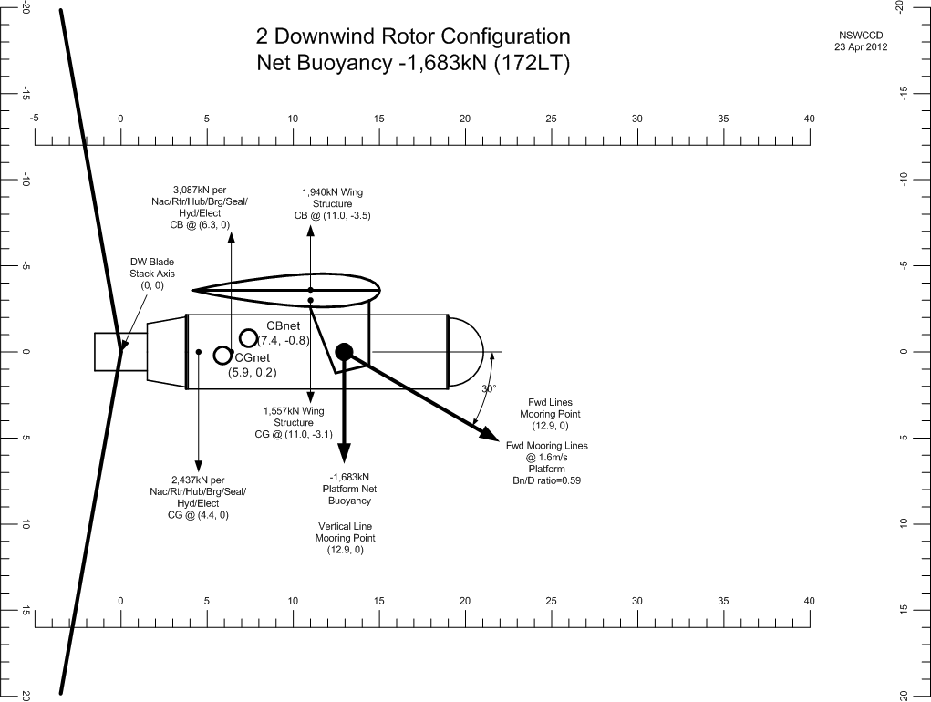
Platform Stability
Mooring Point Locations Required 2 Downwind Rotors
‘Colocated Mooring Attachment’
Notes:
4 ROTOR SKETCH SHOWN
Locations of CB, CG to vary for 2 rotor system
Pitch angle at 1.6m/s flow is 0° (nom. operating).
Other comments for 4 rotor system apply generally

Slide 29
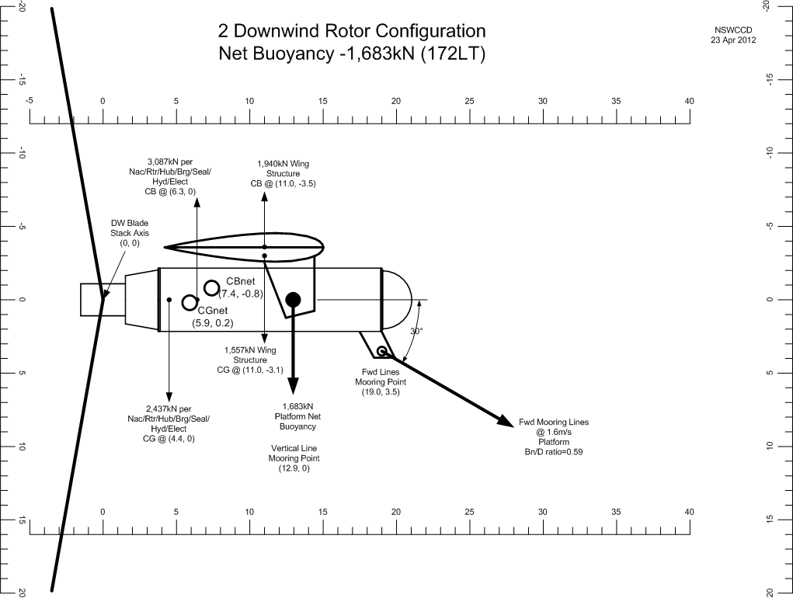
Platform Stability
Mooring Point Locations Required 2 Downwind Rotors
‘Separated Mooring Attachment’
Notes:
Vertical and forward mooring lines are separated to provide better off-axis flow stability (not entangle at severe flow angles)
Locations of CB, CG to vary for 2 rotor system
Pitch angle at 1.6m/s flow is 0° (nom. operating).
Other comments for 4 rotor system apply generally

Slide 30
Dynamic Stability –
Mooring Point Separation
Key Design Choice
  Collocated Mooring Attachment
    Best weathervaning
    Can become tangled if flow reverses
  Separated Mooring Attachment
    Allows weathervaning at small flow angles
    Prevents weathervaning at larger flow angles

Slide 31
Platform Stability
Hydrostatic Stability – 2DW Rotor Platform
  Two (2) Downwind rotors
  Overall weight 6,432kN (646 LT)
  Overall buoyancy 1,683kN (170 LT)
  Fwd mooring lines attach point is +12.9m on nacelle centerline or 19.0m and 3.5m below nacelle centerline from aft rotor reference point (intersection of rotor stacking axis and shaft centerline) for stability with rotors stopped
  Vertical mooring line to limit platform rising in water column during low flow conditions

Slide 32
Platform Stability
2DW Rotor Platform Weights, CG & CB
 | 2-Rotor Platform & Nacelle Weights, CG & CB Locations |  |  |  |  | Based on Mike LaGrassa Weights & Centers file 04_17_2012 |  |  |  |  |  |  |  |  |  | Date: 20 Apr 2012
Item | Component | Qty | Assembly Wt in air |  | Assembly CG location (from aft rotor axis) |  |  | CG Moments (kN-m) |  |  | Assy Displacement (Wt of SW) |  | CB location (from aft rotor axis) |  |  | CB Moments (kN-m) |  |  | Assembly Wt in SW (+ heavy, - buoyant)
 |  |  | kN | lb | X (m) | Y (m) | Z (m) | X | Y | Z | kN | lb | X (m) | Y (m) | Z (m) | X | Y | Z | kN | lb
1 | Rotor Blade Set - DW | 2 | 1,494 | 335,883 | -0.8 | 0.0 | 0.0 | -1,174 | 17 | 0 | 1,075 | 241,617 | -0.8 | 0.0 | 0.0 | -844 | 12 | 0 | 419 | 94,266
2 | Rotor Blade Set - UW | 0 | 0 | 0 | -0.8 | 0.0 | 0.0 | 0 | 0 | 0 | 0 | 0 | -0.8 | 0.0 | 0.0 | 0 | 0 | 0 | 0 | 0
3 | Rotor Hub/Brng/Seal - DW | 2 | 818 | 183,898 | -0.2 | 0.0 | 0.0 | -149 | 0 | 0 | 873 | 196,204 | -0.2 | 0.0 | 0.0 | -159 | 0 | 0 | -55 | -12,306
4 | Rotor Hub/Brng/Seal - UW | 0 | 0 | 0 | 0.2 | 0.0 | 0.0 | 0 | 0 | 0 | 0 | 0 | 0.2 | 0.0 | 0.0 | 0 | 0 | 0 | 0 | 0
5 | Hydraulics - DW | 2 | 451 | 101,426 | 5.3 | 0.1 | 0.2 | 2,413 | 36 | 90 | 0 | 0 | 5.3 | 0.1 | 0.2 | 0 | 0 | 0 | 451 | 101,426
6 | Hydraulics - UW | 0 | 0 | 0 | -5.3 | -0.2 | 0.2 | 0 | 0 | 0 | 0 | 0 | -5.3 | -0.2 | 0.2 | 0 | 0 | 0 | 0 | 0
7 | Nacelle - DW | 2 | 1,882 | 423,183 | 9.4 | 0.0 | 0.0 | 17,656 | -6 | 0 | 4,227 | 950,155 | 9.4 | 0.0 | 0.0 | 39,642 | -14 | 0 | -2,344 | -526,972
8 | Nacelle - UW | 0 | 0 | 0 | -9.4 | 0.0 | 0.0 | 0 | 0 | 0 | 0 | 0 | -9.4 | 0.0 | 0.0 | 0 | 0 | 0 | 0 | 0
9 | Electrical - DW | 2 | 229 | 51,432 | 9.4 | 0.3 | 0.0 | 2,146 | 70 | 0 | 0 | 0 | 9.4 | 0.3 | 0.0 | 0 | 0 | 0 | 229 | 51,432
10 | Electrical - UW | 0 | 0 | 0 | -9.4 | 0.0 | 0.0 | 0 | 0 | 0 | 0 | 0 | -9.4 | 0.0 | 0.0 | 0 | 0 | 0 | 0 | 0
11 | Wing Structure | 1 | 1,557 | 349,985 | 11.0 | 0.0 | -3.5 | 17,126 | 0 | -5,449 | 1,940 | 436,112 | 11.0 | 0.0 | -3.5 | 21,340 | 0 | -6,790 | -383 | -86,127
Platform Totals |  |  | 6,432 | 1,445,807 | 5.9 | 0.0 | -0.8 | 38,018 | 116 | -5,359 | 8,114 | 1,824,087 | 7.4 | 0.0 | -0.8 | 59,979 | -2 | -6,790 | -1,683 | -378,280
Item | Downwind Nacelle (Inbd) Component | Qty | Component Wt in air |  | Component CG location (from aft rotor axis) |  |  | CG Moments (kN-m) |  |  | Displacement (Wt of SW) |  | CB location (from aft rotor axis) |  |  | CB Moments (kN-m) |  |  | Component Wt in SW (+ heavy, - buoyant)
 |  |  | kN | lb | X (m) | Y (m) | Z (m) | X | Y | Z | kN | lb | X (m) | Y (m) | Z (m) | X | Y | Z | kN | lb
1 | Rotor Blade Set - DW | 1 | 747 | 167,941 | -0.8 | 0.0 | 0.0 | -587 | 9 | 0 | 537 | 120,809 | -0.8 | 0.0 | 0.0 | -422 | 6 | 0 | 210 | 47,133
3 | Rotor Hub/Brng/Seal - DW | 1 | 409 | 91,949 | -0.2 | 0.0 | 0.0 | -74 | 0 | 0 | 436 | 98,102 | -0.2 | 0.0 | 0.0 | -79 | 0 | 0 | -27 | -6,153
5 | Hydraulics - DW | 1 | 226 | 50,713 | 5.3 | 0.1 | 0.2 | 1,206 | 18 | 45 | 0 | 0 | 5.3 | 0.1 | 0.2 | 0 | 0 | 0 | 226 | 50,713
7 | Nacelle - DW | 1 | 941 | 211,591 | 9.4 | 0.0 | 0.0 | 8,828 | -3 | 0 | 2,113 | 475,077 | 9.4 | 0.0 | 0.0 | 19,821 | -7 | 0 | -1,172 | -263,486
9 | Electrical - DW | 1 | 114 | 25,716 | 10.9 | 0.3 | 0.0 | 1,249 | 35 | 0 | 0 | 0 | 10.9 | 0.3 | 0.0 | 0 | 0 | 0 | 114 | 25,716
Downwind Nacelle Totals |  |  | 2,437 | 547,911 | 4.4 | 0.0 | 0.0 | 10,622 | 58 | 45 | 3,087 | 693,988 | 6.3 | 0.0 | 0.0 | 19,320 | -1 | 0 | -650 | -146,077
 |  |  |  |  | XCG (m) | YCG (m) | ZCG (m) |  |  |  |  |  | XCB (m) | YCB (m) | ZCB (m)
 | Platform CG & CB Locations |  |  |  | 5.9 | 0.0 | 0.2 |  |  |  |  |  | 7.4 | 0.0 | -0.8
 |  |  | X (m) | Y (m) | Z (m)
 | DW rotor blade stacking axis |  | 0.0 | 0.0 | 0.0
 | (Platform reference point)
 | DW rotor to UW rotor axes
 | Vertical Line Mooring Location |  | 12.9 | Ctr | 0.0
 | Fwd Mooring Point Location |  | 12.9 | Ctr | 0.0
 | Fwd Mooring Point Location |  | 19.0 | Ctr | 3.5

Slide 33
Dynamic Stability
Dynamic Stability – 2DW2UW Rotor Platform
Platform Diving to Reduce Loads
  C-Plane will dive to evade high currents
  Diving/rising depends on mean current strength
    Higher currents (than design) result in diving platform
    Lower currents result in rising platform (limited by vertical mooring line)
  Diving also depends, to a lesser degree, on the current shear
  Following slide shows ideal current profiles used in following simulations

Slide 34
Dynamic Stability
Dynamic Stability – 2DW2UW Rotor Platform
Shear Used
  Six ideal flow contours used in the following slides
  Should be considered together with simulations in measured currents
  Except as noted, simulations use ‘1.6 Shear’
Notes:
ALL OF THESE ARE IDEALIZATIONS MADE TO SIMPLIFY THE COMPLEX FLOW FOR PURPOSES OF UNDERSTANDING THE SIMULATION RESULTS

Slide 35
Dynamic Stability
Dynamic Stability – 2DW2UW Rotor Platform
Flow Shear Effects on Diving
  Shear flow has a minor effect on depth keeping
Notes:
Simulation starts at T=10,000 s after 10,000 seconds of initialization sequences. Each 14,000 second simulations takes ~15 seconds of clock time.

Slide 36
Dynamic Stability
Dynamic Stability – 2DW2UW Rotor Platform
Flow Shear Effects on Diving
  Increase in ideal shear shows diving from 75 m to ~140 m and little increase in UCB2 ( velocity of flow at Rotor 2 axis)

Slide 37
Dynamic Stability
Dynamic Stability – 2DW2UW Rotor Platform
Flow Shear Effects on Diving – Step Change
  Ideal shear shows 10 m depth increase in 100 seconds due to a step change in currents

Slide 38
Dynamic Stability
Dynamic Stability – 2DW2UW Rotor Platform
Flow Direction Change
  Ideal change in flow from 0° to +70°, with no reduction in flow speed or shear.
  Yaw angle does not change significantly (8°).
  A large lateral offset results (-150m).

Slide 39
Dynamic Stability
Dynamic Stability – 2DW2UW Rotor Platform
Wave Effects – Head Seas
  Hurricane size wave (12m Hs) can cause large motions and tension spikes on forward mooring line(s)

Slide 40
Dynamic Stability
Dynamic Stability – 2DW2UW Rotor Platform
Wave Effects – Head Seas
  Effects of 7 m waves will be much smaller

Slide 41
Dynamic Stability
Dynamic Stability – 2DW2UW Rotor Platform
Wave Effects – Beam Seas
  Effects of 7 m waves in beam seas will be smaller still

Slide 42
Dynamic Stability
Dynamic Stability – 2DW2UW Rotor Platform
Conclusions
  Undoubtedly hydrostatically stable with vertical line attached, with trim near zero pitch
  Undoubtedly will dive to evade higher currents in most if not all conditions
    Outlier conditions, of high currents and reverse shear requre further study and is a risk area
  Changing flow directions, at this point, is a risk in stability area
    Four (4) rotor model of platform can handle this effect for most conditions
    Examination of potential outlier conditions needs to be done
    Fallback is to install tails or other devices to increase stability
    Changing flow directions should be considered for basin test
  Simulations in waves show the following
    Storm waves in head (and following) seas can cause high pitch values and requires further study
    7 m SWH head seas waves appears to result in acceptable forward mooring line tensions
    7 m SWH beam seas results in much less motion in this model (which has no truss)
  Complete hydrodynamic stability for all flows measured to date appears, achievable, but has not been demonstrated in numerical simulations to date
  Stability without rotors turning, and lateral plane motions in general, are risks
  Motion based loads require further study
Notes:
7 m SWH HAS <6% CHANCE OF OCCURRING IN OPEN NOTHERN HEMISPHERE

Slide 43
WORK DO BE DONE FOR 2 ROTOR VARIANT
Dynamic Stability – 2 ROTOR EFFORT
  ARRIVE AT STATICALLY STABLE DESIGN
    USE 3-CABLE MOORING SCHEME
      FOUND TO BE THE BEST
      MOORING POINT ATTACHMENT SEPARATION T.B.D.
    OBTAIN ROTOR COEFFICIENTS
    OBTAIN OTHER VEHICLE COEFFICIENTS
    BUILD COMPLETE COMPONENT MODEL
  REDO DYNAMIC SIMULATIONS AS PER 4 ROTOR VERSION
  EXTEND SIMULATIONS
    TURBULENCE
    ADDITIONAL CURRENT PROFILES, AND ADDITIONAL TIME VARIATION
    CASUALTIES, LOSS OF ROTOR BACK-TORQUE, LOSS OF BLADE, ETC
  WRITE REPORT
  DESIGN BASIN TEST TO TEST IMPORTANT DYNAMIC ASPECTS OF DESIGN
    REDUCED FLOW OVER ONE ROTOR, VERTICAL SHEAR, ETC
    VARYING AZIMUTHAL FLOW DIRECTION
  COMPARE BASIN TEST RESULTS TO SIMULATION RESULTS, AND IMPROVE, REDO SIMS IF REQUIRED
Notes:
7 m SWH HAS <6% CHANCE OF OCCURRING IN OPEN NOTHERN HEMISPHERE

Slide 44
SUMMARY
STATE-OF-THE-ART LABORATORY FACILITIES
PHYSICALLY REALISTIC ANALYTICAL SIMULATIONS
2 AND 4 ROTOR WORK COMPLETED
3-CABLE SYSTEM IS BEST MOORING SCHEME
NO SHOW STOPPERS FOUND
  STATIC STABILITY UNDOUBTEDLY ACHIEVABLE
  DYNAMICALY STBLE RESPONES FOUND FOR ALL FOR ALL CONDITIONS TO DATE FOR 4 ROTOR SYSTEM
EXPECT A DYNAMICALLY STABLE 2 ROTOR DESIGN

Slide 46
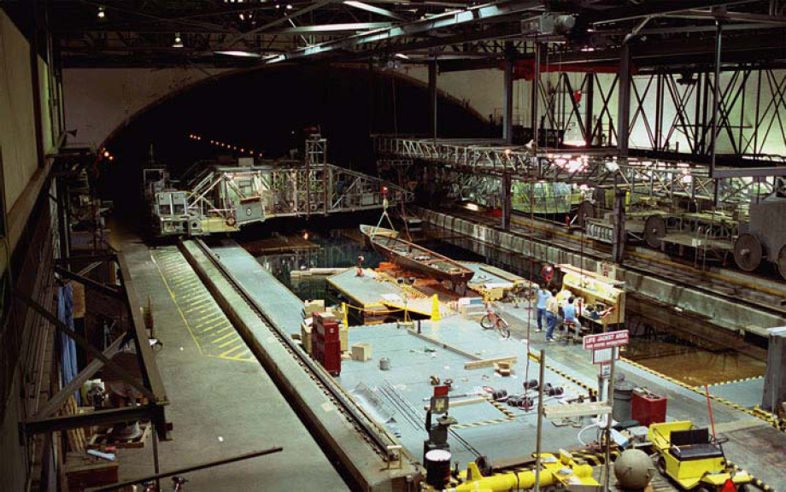
Scale Model Testing
  In order to mitigate the technical risk level (TRL) of the C-Plane hydrodynamic stability from a TRL=4 to a TRL=7, model testing of a geometric similar model of scale factor 1/25 is planned for the 2nd quarter of CY2012 in the Deep Water Basin facility at the NSWCCD, Bethesda, MD.
  The Basin has dimensions of :
      Width: 15.5m (51 ft)
      Depth: 6.7m (22 ft)
      Length: 575m (1,886 ft)
      Tow Carriage Speed: 10m/s (19 knots)

Slide 47
Scale Model Testing
  1/25-scale Model Characteristics
    Rotor diameter: 1.60m (5.25 ft)
    Nacelle diameter: 0.18m (0.59 ft)
    Nacelle length: 0.80m (2.6 ft)
    Support Structure - Wing
      Length: 1.83m (6.0 ft)
      Width: 0.43m (1.4 ft)
      Height: 0.1m (0.33 ft)
    Weight (dry): 0.41kN (93 lb)
    Net Buoyancy: 0.11kN (25.2 lb)

Slide 48
Model Test Scaling Effects
  The Navy routinely tests ship and submarine models in the 1/20th- to 1/30th-scale factor range with reliable and accurate full-scale correlation
  Froude scaling is the correct scaling approach in which gravitational effects (platform weight and buoyancy) are major contributors to the characteristics that control stability.
    Froude scaling laws dictate the following scaling factors (λ=1/25 of full scale)
    Linear properties (length, area, volume) scale according to the linear property to the exponent factor (length = λ¹, area = λ², volume = λ³)
    Mass and force properties scale as the cube of the scale factor (λ³ )
      Test measured forces would be multiplied by 15,625 to determine full-scale forces
    Velocity scales as the square root of the factor (λ^{1/2} )
      Model scale current speeds are 1/5 of full scale (1.6m/s = 0.32m/s model)
    Time scales as one over the square root of the factor (λ^{-1/2} )
      Measured response times are 5 times faster than full scale responses

Slide 49
Model Test Scaling Effects
  Rotor blade forces are predominantly fluid momentum dominated effects (hydrodynamic or aerodynamic forces) and are typically scaled by matching the Reynold’s number of the component
  Rn = VL/ν
    where V is the velocity in ft/s
    L is the characteristic length in ft
    ν is the kinematic viscosity of the fluid in ft²/s
  Rn = 2.87E7 for full scale rotor blade tip with TSR = 10
  Rn = 2.79E4 for the Froude scaled rotor blade tip
  Thus, the model scale rotor blade hydrodynamic generated forces may not scale correctly since the ratio in Rn values is a factor of 1,000. This could change the lift and drag coefficient values that are based on Rn effects. These differences in measured rotor lift and drag forces could effect the platform stability since rotor drag is a major contributor to the overall platform force.

Slide 50
Model Test Reynold’s Number Scaling Effects
  Rotor blade forces are predominantly fluid momentum dominated effects (hydrodynamic or aerodynamic forces) and are typically scaled by matching the Reynold’s number of the component
  Rn = VL/ν
    where V is the velocity in ft/s
    L is the characteristic length in ft
    ν is the kinematic viscosity of the fluid in ft²/s
  Rn = 2.87E7 for full scale rotor blade tip with TSR = 10
  Rn = 2.79E4 for the Froude scaled rotor blade tip
  Thus, the model scale rotor blade hydrodynamic generated forces may not scale correctly since the ratio in Rn values is a factor of 1,000. This could change the lift and drag coefficient values that are based on Rn effects. These differences in measured rotor lift and drag forces could effect the platform stability since rotor drag is a major contributor to the overall platform force.

Slide 51
Model Test Reynold’s Number Scaling Effects
  In order to obtain the correct drag force on the model the nacelle/rotor assembly will be equipped with a motor/tach/encoder that will power the rotor blades and accurately measure the rotor rpm.
  The nacelle/rotor assembly will be capture towed in the basin mounted to a force measuring sensor that will record the drag load of the assembly as a function of rotor blade rpm. The rpm that matches the scaled full-scale rotor drag force at the speed of interest will be used for the platform testing. This ensures the correct rotor drag forces will be exerted on the platform for stability evaluations.

Slide 52
Scale Model Testing
  Tow tank testing scheduled for 10 September – 28 September 2012
  Testing consists of the following test scenarios:
    1. Single nacelle/rotor assembly drag calibration
    2. Captured model testing using build-up method
      Measure 6 DOF forces and moments of the platform using a pitch and yaw adjustable apparatus mounted on a submerged strut/sting
      Support Structure (Truss) only
      Truss + nacelles (4ea, no rotor blades)
      Truss + nacelles (4ea) + rotor blades (4 sets)
      Pitch angle variation -25° to +25°
      Yaw angle variation -40° to +40°

Slide 53
Scale Model Testing
  Testing scenarios (cont’d):
    3. Free-towing of the C-Plane platform using a simulated mooring system
      Free-tow of the platform may be performed with the model inverted and the simulated mooring lines anchored to the underside of the tow carriage. Model ballasting and the effects of gravity and buoyancy will need to be investigated for feasibility for the inverted mode. With this test method changing the locations of the mooring lines would be simple and can simulate off-axis current directions.
      Free-tow of the upright platform using a framework protruding into the water to anchor the mooring lines. Gravity and buoyancy effects are acting in the proper manner for stability assessment. Performing off-axis test conditions may be more difficult.
    4. Develop a flow blockage rig to install in front of one rotor to simulate reduced flow through the rotor disk and to induce yaw

Slide 54
Scale Model Testing
  Data Analysis
    Forces and moment data obtained from testing will be used to predict the full scale forces and moments acting on the platform
    Forces and moments data plotted with respect to pitch and yaw angle will be used to compute hydrodynamic coefficients for comparison with analysis coefficients used to predict platform stability. Stability analyses will be recomputed using revised coefficients.
    Video from the free-tow testing will be reviewed for platform behavior indicating instability regions.
    Above data analysis will be used to feed design changes to the prior to Critical Design Review and increase the TRL

